Slide 1
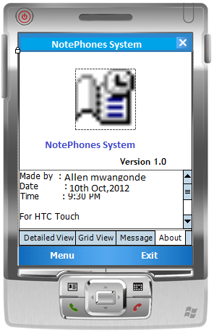
NOTEPHONES SYSTEM
University of the Western Cape
Computer Science (Hons)
Allen Mwangonde
alwahco@yahoo.co.uk
Supervisor: Isabel M. Venter

Slide 2
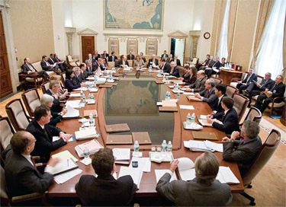
Overview
User requirements
Analysis of user requirements
Tools to be used
Limitations
Project plan
References

Slide 3
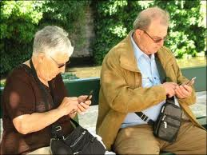
User requirements
Simple and easy to use interface.
simple description for every button, not too complicated
Complete minutes management
Capturing minutes,audio,agendas etc
Fully configurable
to change the alert time or schedules .Add minutes or apology
no need to restart the system after changing the settings
Quality security measures
restrict access to members only. Minutes are legal.
Reminders for scheduled events
alerts for all current and upcoming meetings.
Compatibility with all phones

Slide 4
Analysis of user requirements
Self explanatory with simple interface language
No complicated terminology, easy to follow instructions,ie user friendly
User authentication process-unique #s,password
easy access to minutes –stand alone
automated messaging
alert participants on meeting dates and times and their duties
Not capturing of audio and videos
lightweight process
to run on smartphones devices.
simplifying the organization and cross-referencing of minutes
According dates,months,subject etc.

Slide 5
Tools to be used
software platform
Computer
Windows 7
mobile
.NET Compact Framework (.NET CF) 3.0
Windows Mobile 6 Standard SDK Refresh
Windows Mobile 6.0 Professional SDK Refresh
Windows mobile device centre
Database
SQL Server 2005 CE (Compact Edition)
SQL Server 2005 CE SDK
Programming language
Visual Studio 2008 Service Pack 2 (SP2)
Modelling
Microsoft Visio 2010

Slide 6
Limitations
Capturing of minutes automatically
Audio recordings of minutes
.NET Compact Framework (.NET CF) 3.0 and SQL Server CE (Compact Edition) environment only e.g. Smart phone,PDAs,
Not expected
capture minutes automatically
audio recordings of minutes
the secretary have to do

Slide 7
Conclusion
This project sets out to create a minute management system which will be simple and easily accessed by mobile devices. Such a system will alleviate some of the problems associated with paper-based and web-based systems.

Slide 8
Project Plan
TERM | DATE OF SUBMISSION | SUBMITTED
1.Porject Analysis User requirement document Requirement analysis document Presentation one | 2012/03/30 | YES YES YES
2.Project Design and Development | 2012/05/25 | NO
3.Project Implementation | 2012/08/31 | NO
Project Testing, Evaluation and Presentation | 2012/11/02 | NO

Slide 9
Reference
Landay, J. A. (1999). Making sharing pervasive: Ubiquitous computing for shared note taking. IBM SYSTEMS JOURNAL, 38(4).
Luz, M.-M. B. (2006, 10 24). Meeting browsing.
Mahangu, A. (2010). Minutes Management System. Cape Town: University of the Western Cape.
Marc, P. ( 2001, October ). Digital Natives Digital Immigrants. Vol. 9 ( No. 5).

Slide 10
QUESTIONS
UWC
Thank you for your attention

